Slide 1







Generalized ODIN: Detecting out-of-distribution image without learning from out-of-distribution data
CVPR 2020 – Conference on Computer Vision and Pattern Recognition
Yen-Chang Hsu¹, Yilin Shen², Hongxia Jin², Zsolt Kira¹
Georgia Institute of Technology¹, Samsung Research America²

Slide 2
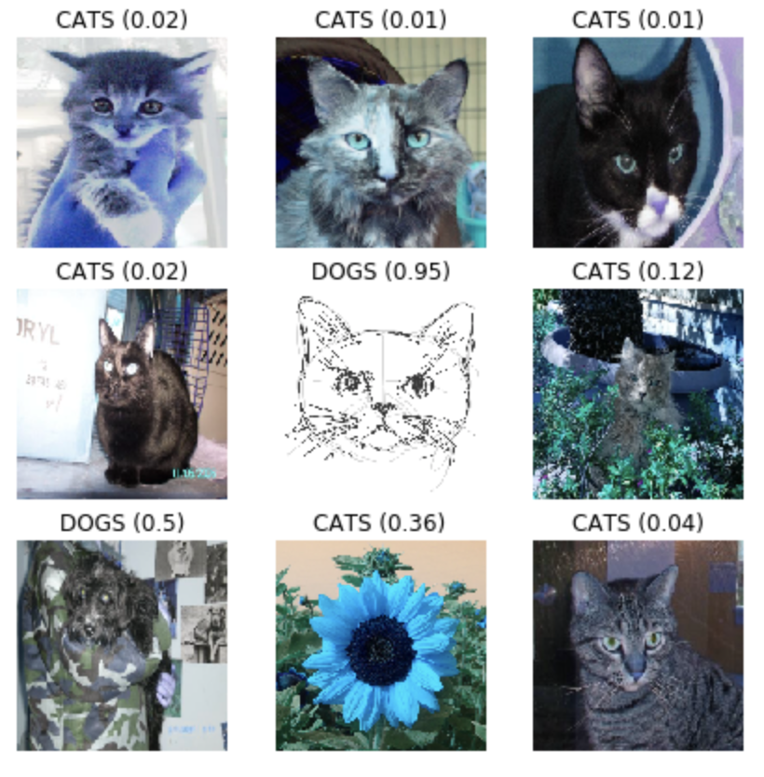
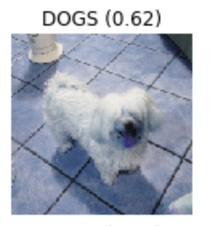
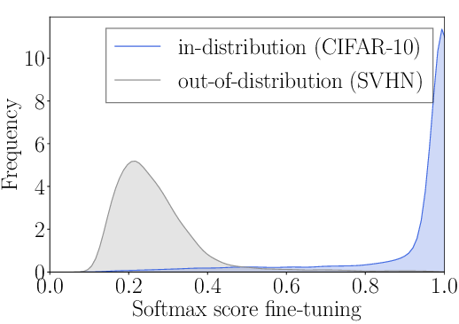


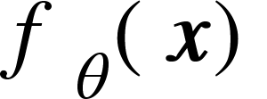
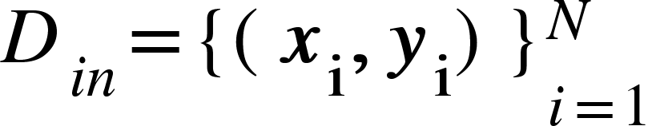
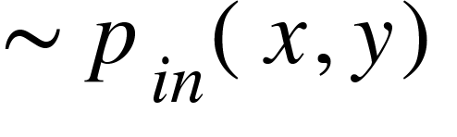
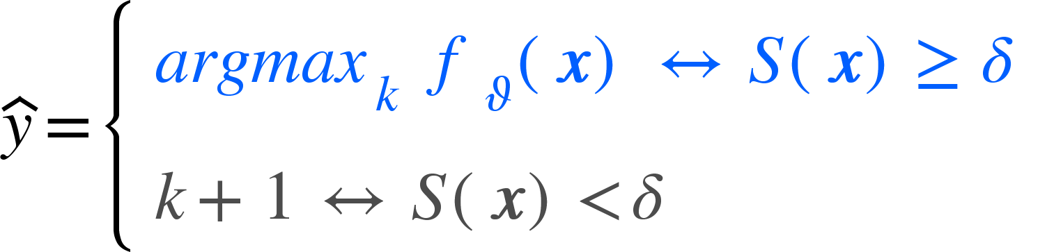
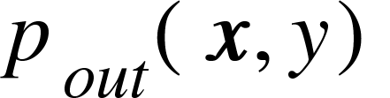
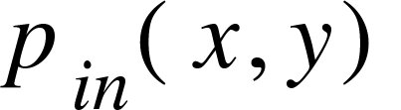
One step back: OOD detection in classification
Good reading: Are open set classification methods effective on large-scale datasets? Ryne Roady, Tyler L. Hayes, Ronald Kemker, Ayesha Gonzales, Christopher Kanan
Taste the issue: /cat_vs_dogs_FT
How can we detect whether an input data is from in-distribution (i.e. the training distribution) or out-of-distribution?
𝜎 / softmax
GUILTY!
?!

Slide 3
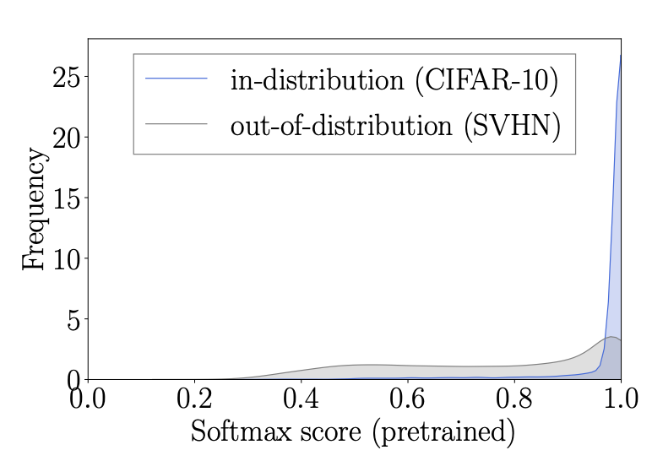
Hendrycks baseline (2017)
Good reading: A Baseline for Detecting Misclassified and Out-of-Distribution Examples in Neural Networks Dan Hendrycks, Kevin Gimpel
Prediction probability of out-of-distribution examples tends to be lower than the prediction probability of in-distributed examples.
Setting a global threshold on the maximum value of the softmax predictions.
Problem: difference between in- and out- distributions could be subtle.
Credit: Energy-based Out-of-distribution Detection Weitang Liu, Xiaoyun Wang, John D. Owens, Yixuan Li

Slide 4
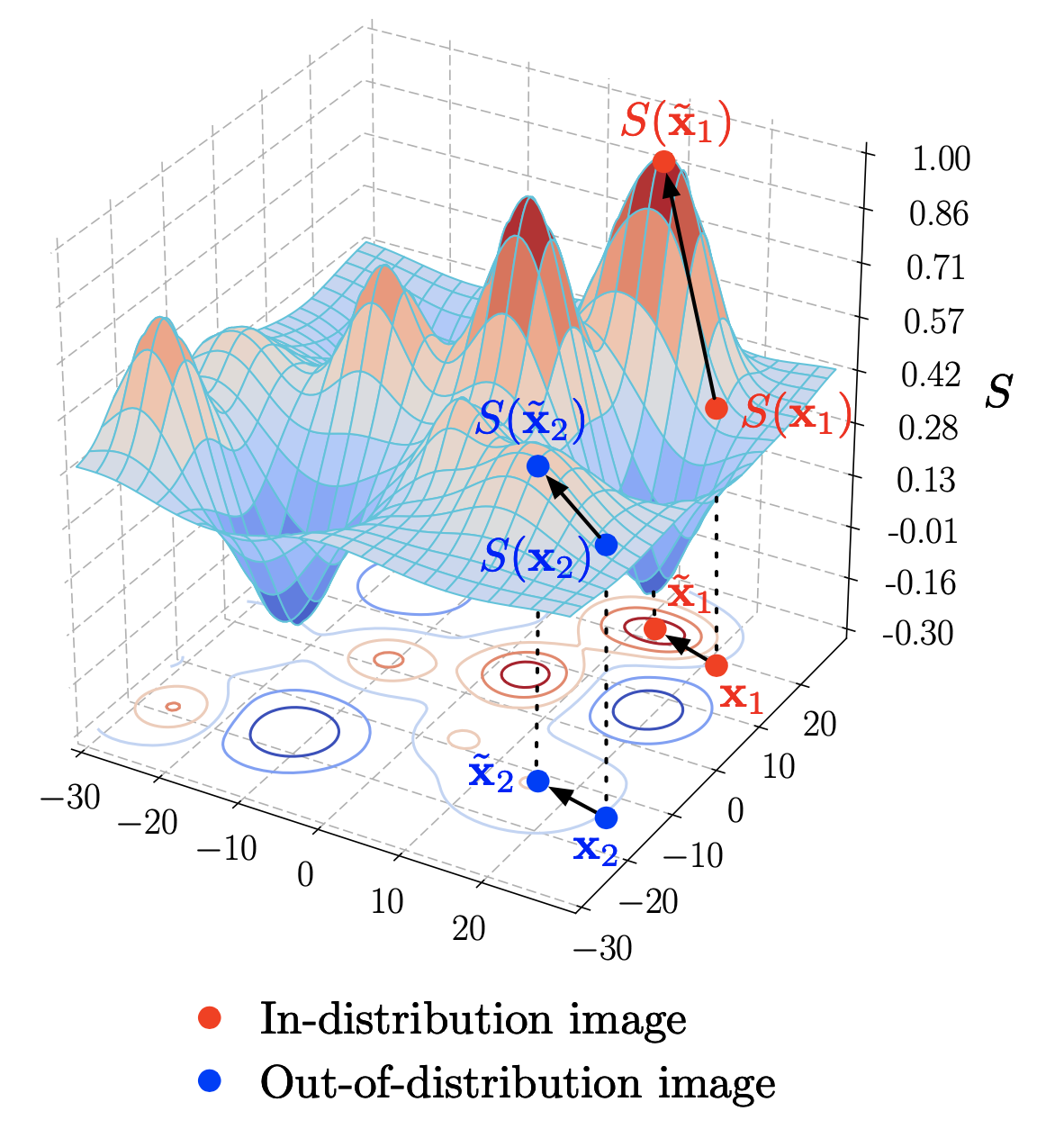
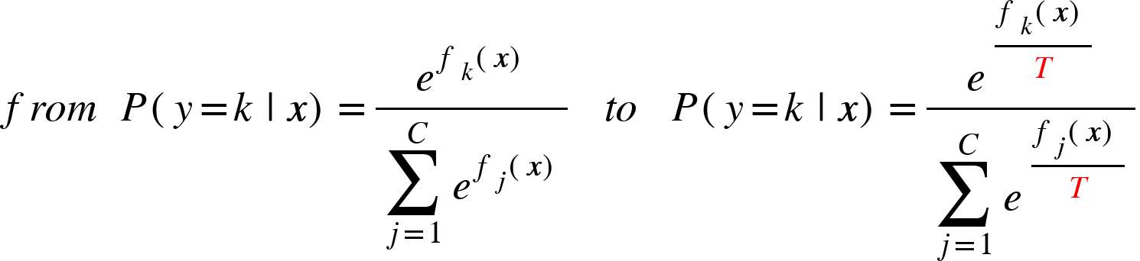


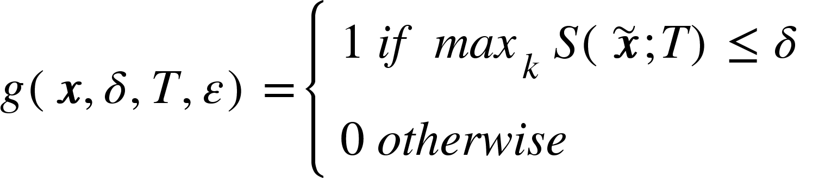
ODIN: a new state-of-the-art (2018)
Good reading: https://github.com/facebookresearch/odin/tree/main/code
Temperature scaling for spreading weights over other classes:
Pre-process the input by adding a small perturbation.
feed the pre-processed image again and check the score.
Credit: Enhancing The Reliability of Out-of-distribution Image Detection in Neural Networks Shiyu Liang, Yixuan Li, R. Srikant

Slide 5
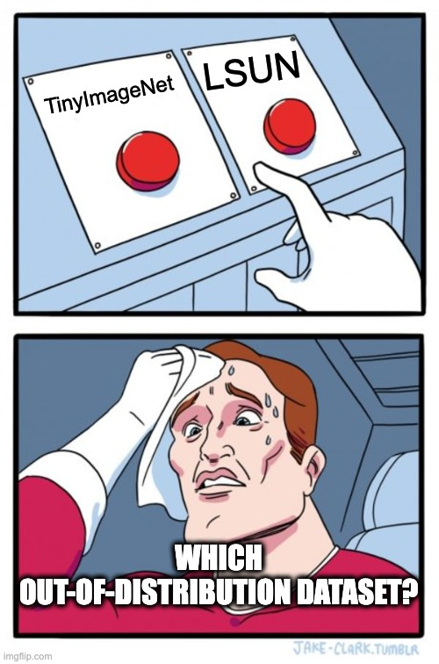

ODIN: a new state-of-the-art (2018)
Literally from the paper: “The parameters T, ε and δ are chosen so that the true positive rate (i.e., the fraction of in-distribution images correctly classified as in-distribution images) under some out-of-distribution image data set is 95%.”
TRAIN over in-distribution data
Using a vanilla classifier
TUNE the parameters ε, T used by the scoring function S over a validation dataset composed by in-distribution and OOD data.
those hyperparameters are specifically tuned for each OOD dataset.
ODIN
Problem: lack of generalization
EVALUATION METRIC over in-distribution and out-distribution images for 𝛿 (inference complexity)

Slide 6
Generalized ODIN: OOD data? No, thanks!
TRAIN over in-distribution data
Using a vanilla backbone + a dividend/divisor structure
TUNE the parameter ε used by the scoring function S over a validation dataset composed by only in-distribution data.
those hyperparameters are specifically tuned for each OOD dataset.
A modified input pre-processing method without tuning on OOD data.
OOD data is hard to define a-priori.
A new perspective of decomposed confidence.
A new classifier design by considering whether the closed-world assumption holds or not.
Generalized ODIN
EVALUATION METRIC over in-distribution and out-distribution images for 𝛿 (inference complexity)

Slide 7
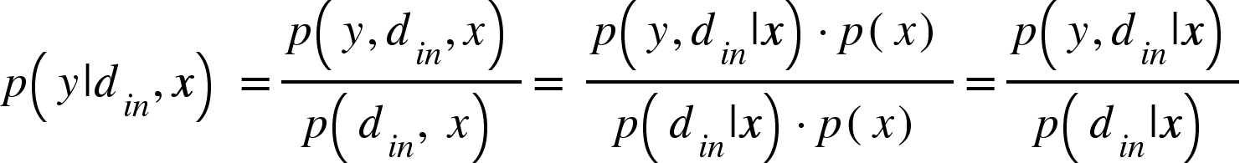
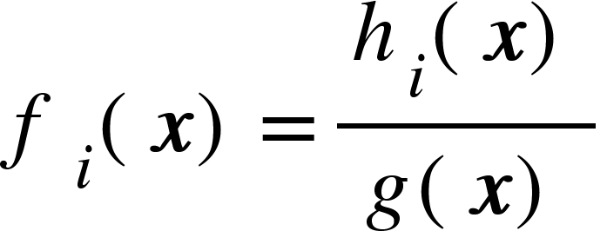
Method: decomposed confidence
TRAIN
GEN. ODIN
A standard network is trained in order to try to predict the posterior probability p(y | x) = p(y | din, x) where din is the event for which the input belongs to the training distribution. Applying the Bayes rule:
joint class-domain probability
Force the network to have a dividend/divisor structure and let hi(x) behave like p(y,din|x) and g(x) behave like p(y|din,x).
ƒ logit for class i
domain probability = probability x falls in the in-distribution
EXACTLY WHAT WE NEED!

Slide 8
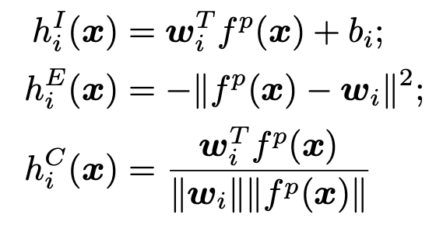

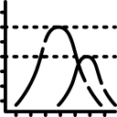

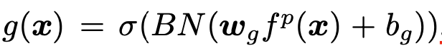
Method: decomposed confidence
TRAIN
GEN. ODIN
The overall network has two branches after its penultimate layer.
At training time the model calculates the logit followed by the softmax function with the cross-entropy loss on top.
→ DeConf-I* — inner product
learning hi
→ DeConf-E* — neg. euclidean
→ DeConf-C* — cosine similarity
backbone
softmax
learning g

Slide 9
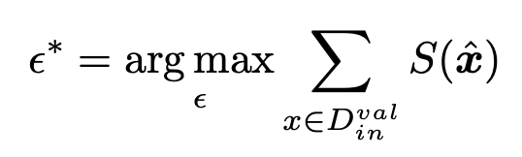
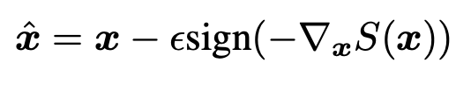
Method: modified input pre-processing (IPP)
Literally from the paper: “we argue that a ε which makes a large score increase for in-distribution data should be sufficient to create a distinction in score”.
TUNE
GEN. ODIN
01 - Feed x and compute the scoring function S – max hi(x) or g(x)
Note: images come only from a in-distribution validation set Dval.
04
04 - Search the best magnitude
02- Apply the perturbation
Pre-processing step using the gradient of S and a certain magnitude. Note: the search of 𝜀* is done among a coarser grid — [0.0025, 0.005, 0.01, 0.02, 0.04, 0.08] — and does not require neither to access any performance metrics nor the class labels of the validation set.
01
03
02
03- Collect all the calibrated scores for Dval testing the magnitudes along the grid.

Slide 10
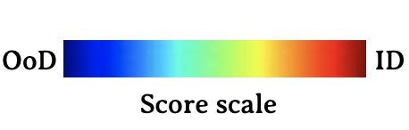
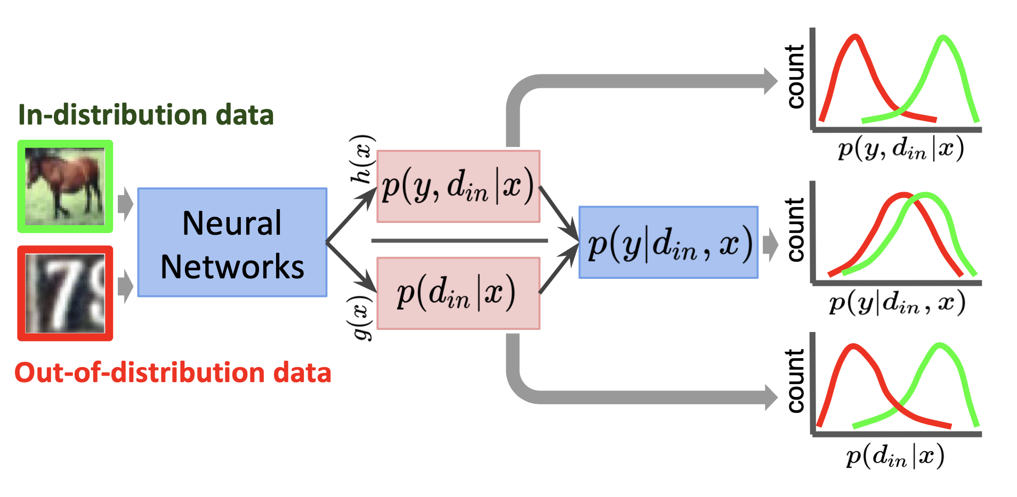
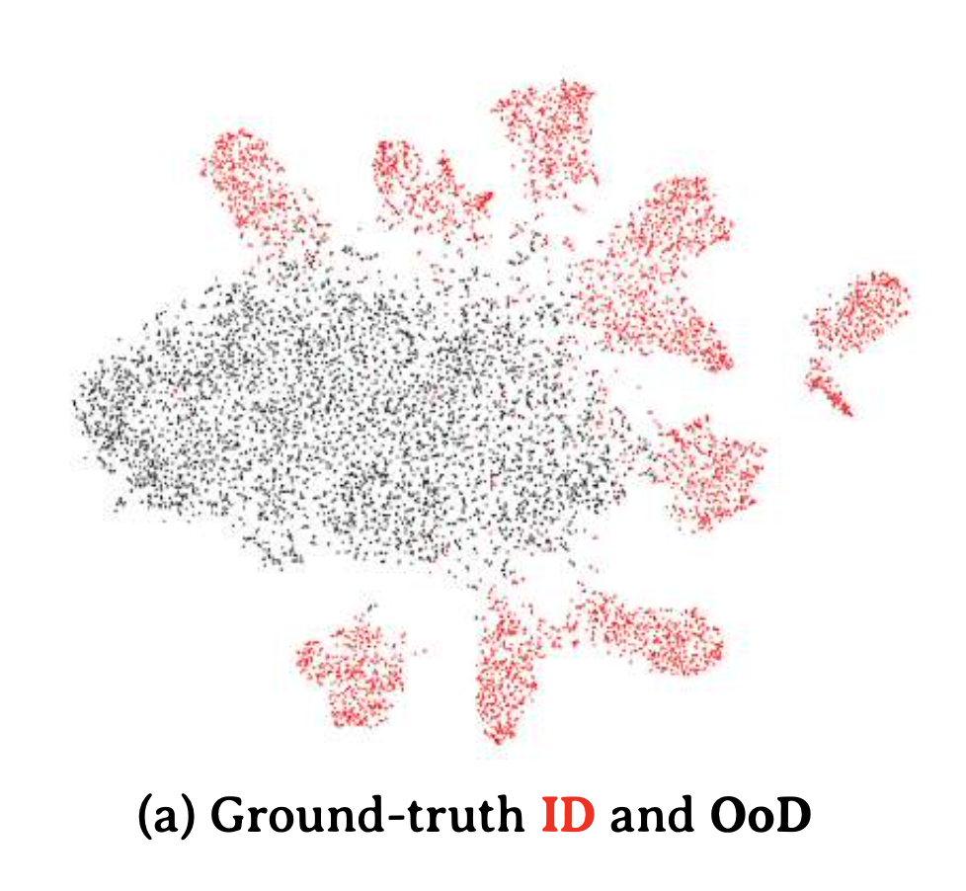
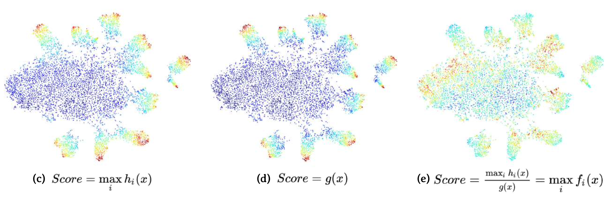
Method: performance metric evaluation
GEN. ODIN
EVALUATION
Use TNR@TPR95 for putting a threshold. The decomposed probabilities are less overconfident and can reject the out-of-distribution images better than a standard classifier.
Visualization of the score distribution. The data are visualized with t-SNE using the features from the penultimate layer of the neural networks. The results are from DeConf-I with ResNet-34. The figure (a) visualizes the ground-truth in-distribution (ID, red, CIFAR-10) and out-of-distribution (OoD, black, Imagenet-resized) data. The scores are obtained from (c) h function, (d) g function, or (e) the logits, and the scores are re-scaled for visualization.

Slide 11
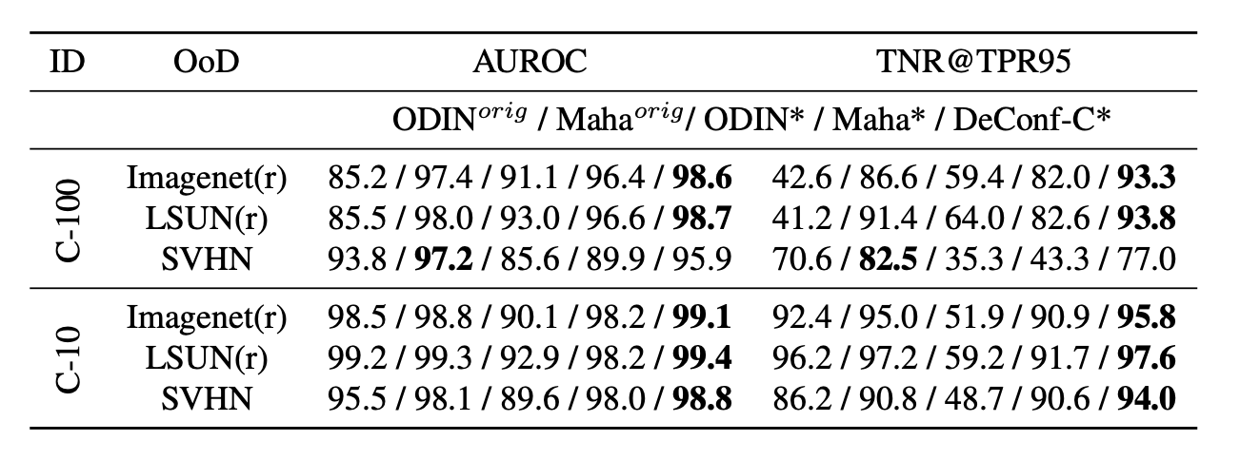
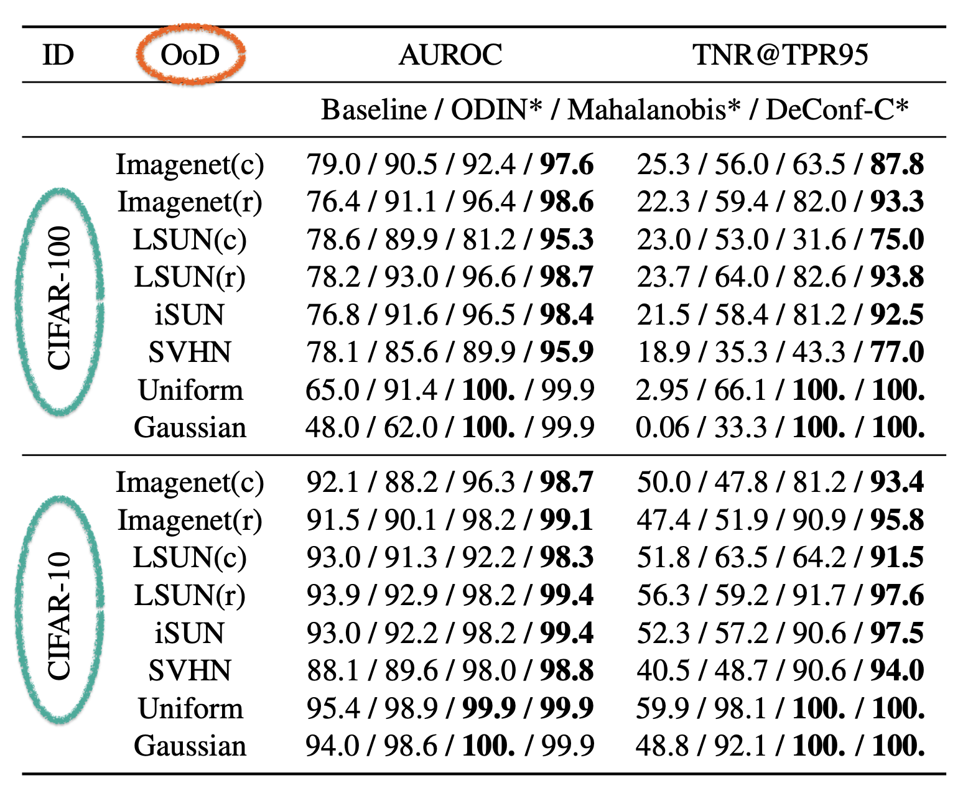
Experimental results
Classifier backbone:
Evaluation metrics:
DenseNet
ResNet
WideResNet
AUROC
TNR@TPR95
OOD datasets
ImageNet (cropped and resized)
LSUN (cropped and resized) iSUN (subset of LSUN)
Uniform Noise (i.i.d uniform distribution on [0,1])
Gaussian Noise (i.i.d. gaussian distribution on [0,1])
SVHN (colored street numbers)
Baseline: Hendrycks
ODIN*: mix ODIN with T=1000 with 𝜀 as in IPP
Mahalanobis*: mix Mahalanobis distance (𝛼=1) with 𝜀 as in IPP
OUR – DeConf-C*: h with cosine similarity

Slide 12
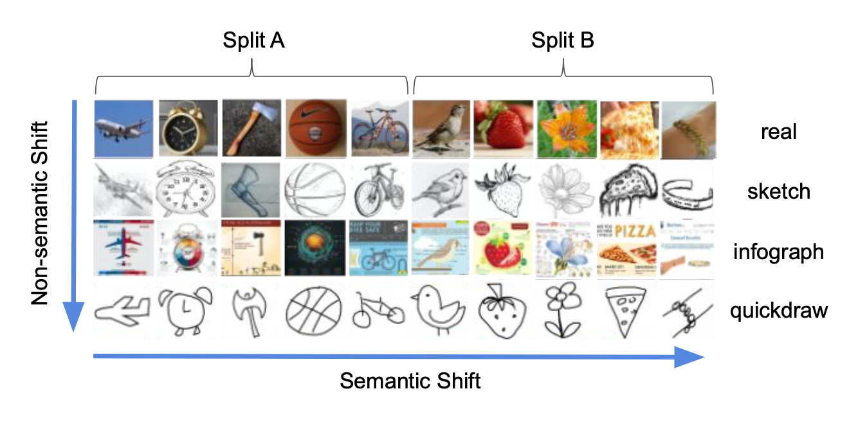
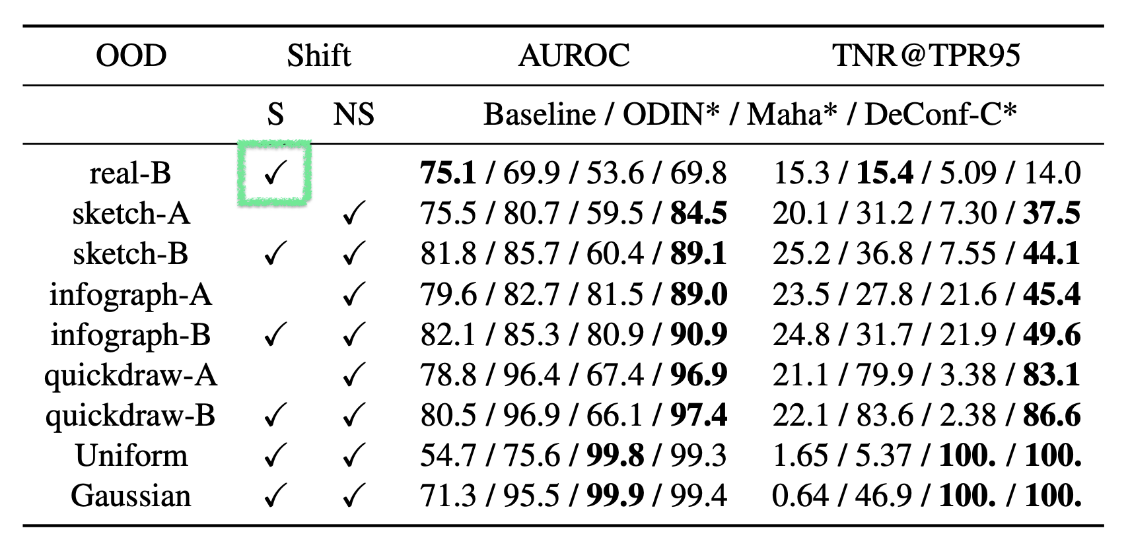
Experimental results
Classifier backbone:
Evaluation metrics:
DenseNet
ResNet
WideResNet
AUROC
TNR@TPR95
OOD datasets (DomainNet)
Split-B real
Split-B and Split-A sketch
Split-B and Split-A infographic
Split-B and Split-A quickdraw
Uniform
Gaussian
Baseline: Hendrycks
ODIN*: mix ODIN with T=1000 with 𝜀 as in IPP
Mahalanobis*: mix Mahalanobis distance (𝛼=1) with 𝜀 as in IPP
OUR – DeConf-C*: h with cosine similarity

Slide 13
Thanks for your attention
any questions?
Takeaway
01 | Learning OOD detection without OOD data is feasible.
02 | New paradigm of decomposed confidence, directly modelling p(din|x) as scoring function.
03 | Pre-processing method inspired to ODIN, without tuning on OOD data.

